Slide 1
System of System Integration Technology and Experimentation (SoSITE)
Jimmy “Reverend” Jones, Lt Col, USAF
Program Manager, DARPA/STO
Technology and experimentation to enable rapid and custom integration of any distributed architecture
Prepared for 2019 NDIA-SE Conference
Presented by: Chris “Lude” Kibble (SoSITE SETA)
23 Oct 2019
Distribution Statement “A” (Approved for Public Release, Distribution Unlimited)

Slide 2
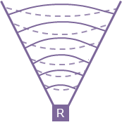
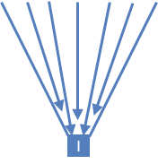
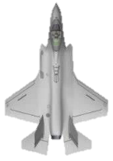
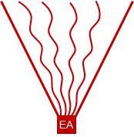
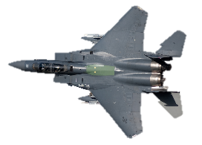
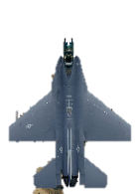
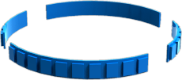
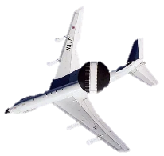
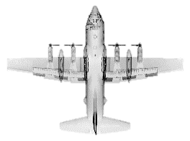
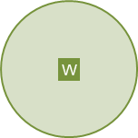
Interoperability Issues Abound in the DoD
Adding interoperability between aircraft takes years
Aircraft are upgraded independently creating unique messages
Machine-to-machine interfaces in an aircraft are highly coupled
Even coupling between versions of the same spec (e.g., Link-16) is problematic
This interoperability problem occurs within the aircraft as well
Components are tightly coupled together using a local message standard that doesn’t match the documentation
Adding new technology (e.g., sensor) requires upgrades to multiple components, increasing expense and time
W
W
Legend
Radar
W
W
MC
R
I
Each aircraft is collection of independent subsystems designed at different eras requiring interoperability
Imagery
EA
W
Interoperability is programmed into each system System upgrades compete in 2-3 year block cycles
Global standards have similar issues
No interoperability between generations of the standard
Uncertain interoperability between implementations
Electronic Attack
W
W
Warning System
Distribution Statement “A” (Approved for Public Release, Distribution Unlimited)
Notes:
Source: DISTAR 31297 brief for 2019 SPIE conference - slide #4

Slide 3
STITCHES is a toolchain to generate interoperability
STITCHES efficiently generates message translators
System software is modified once for STITCHES compatibility
Generated code is uploaded like mission data files (MDFs)
Allows for fast and easy reconfiguration of mission capabilities
Auto-generate efficient glue code to
Interoperate between new subsystems and existing components; old and new generations of the “same” open specification
Transform platform data to comm’s message formats or encode any message inside fixed format standards like Link-16
W
W
W
W
A mission computer’s (MC) software is modified to allow STITCHES MDFs to translate and control data flow
MC
R
I
Any data on buses connected to STITCHES MDFs may be translated and rerouted inside or outside an aircraft
EA
W
Message
STITCHES MDFs efficiently translate data and control data flow in order to create interoperability between and within connected platforms
W
W
Distribution Statement “A” (Approved for Public Release, Distribution Unlimited)
Notes:
Source: DISTAR 31297 brief for 2019 SPIE conference - slide #5

Slide 4
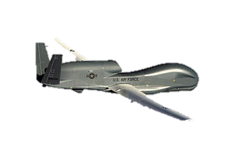
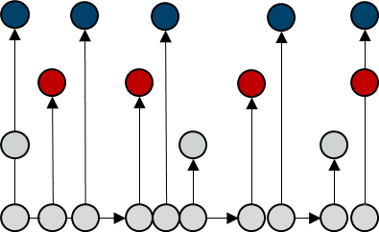
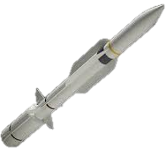
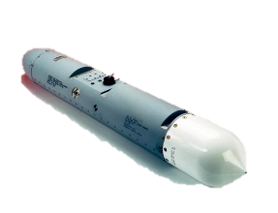
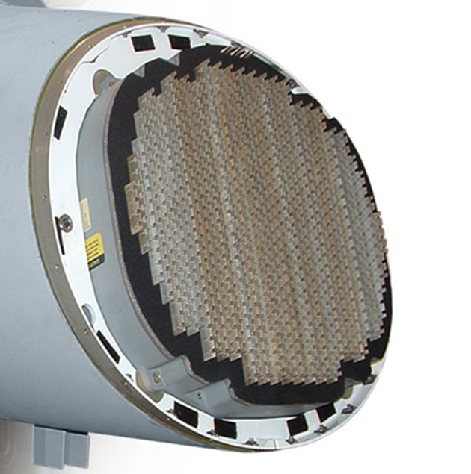
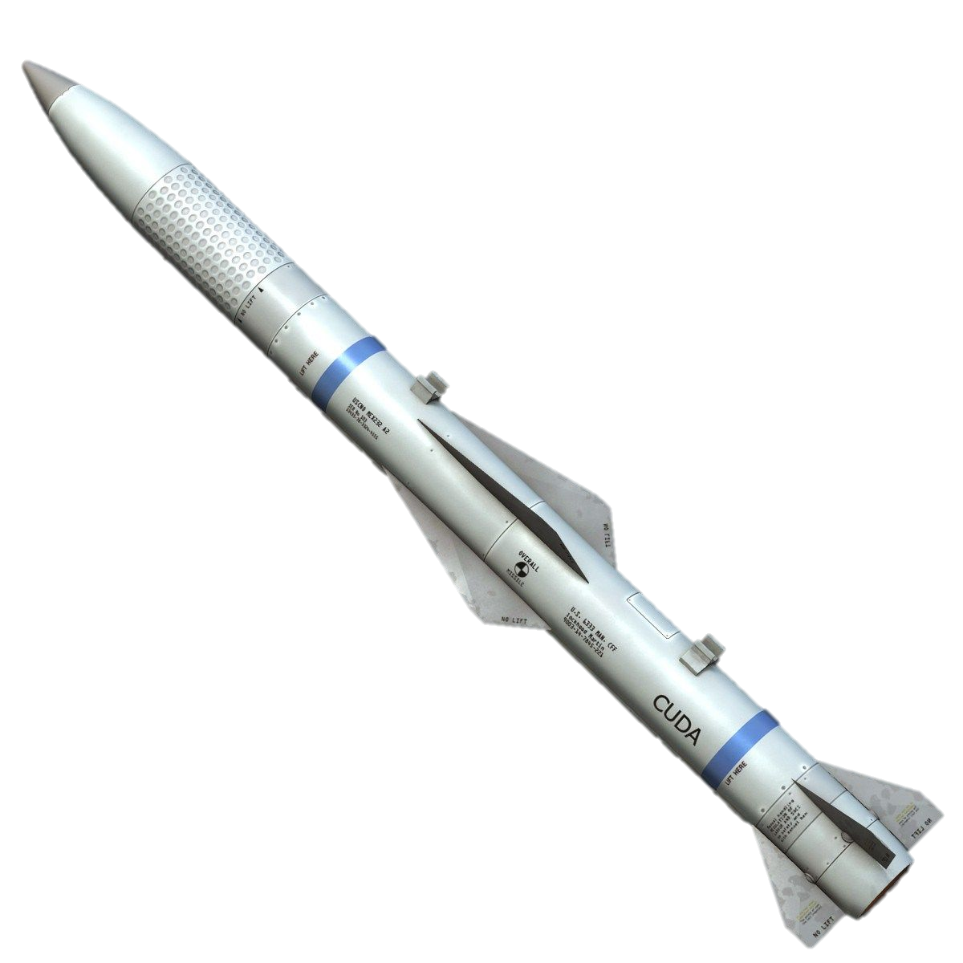
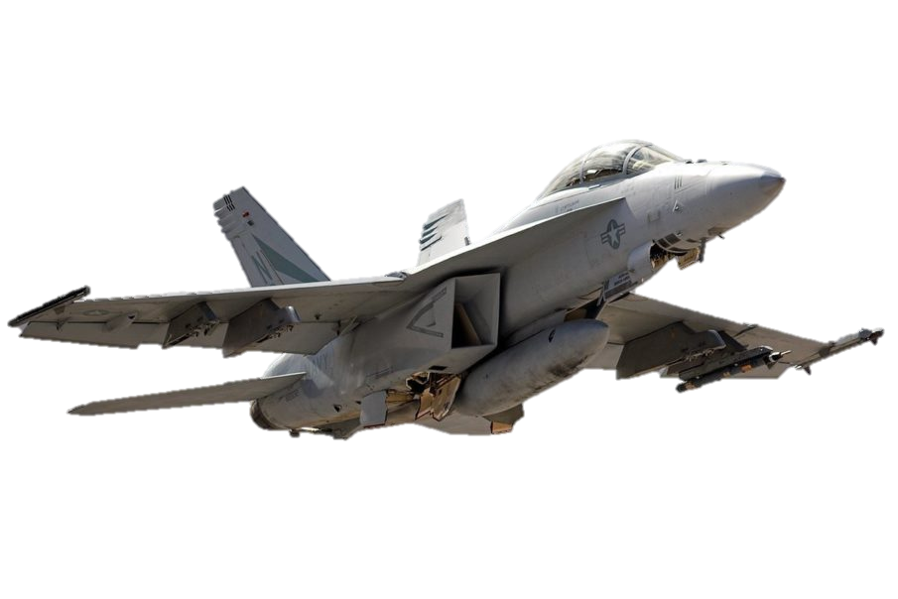
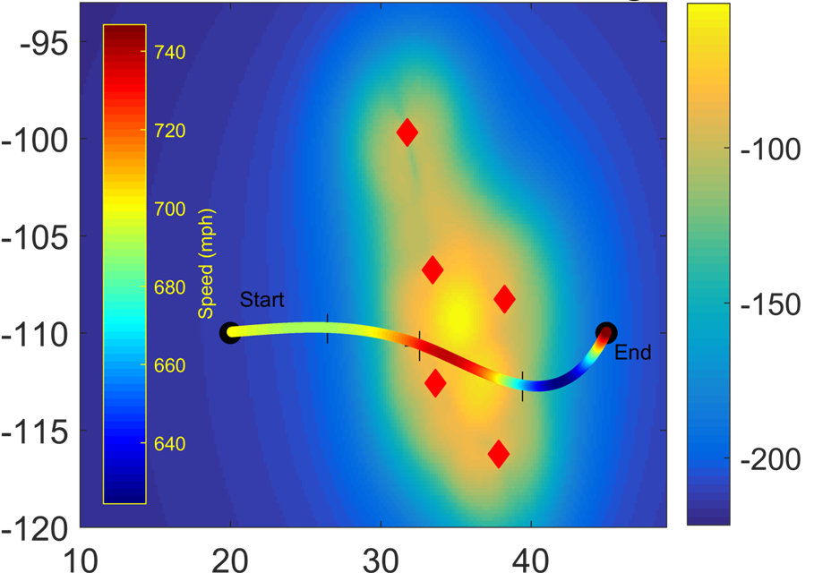
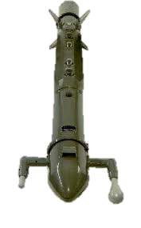
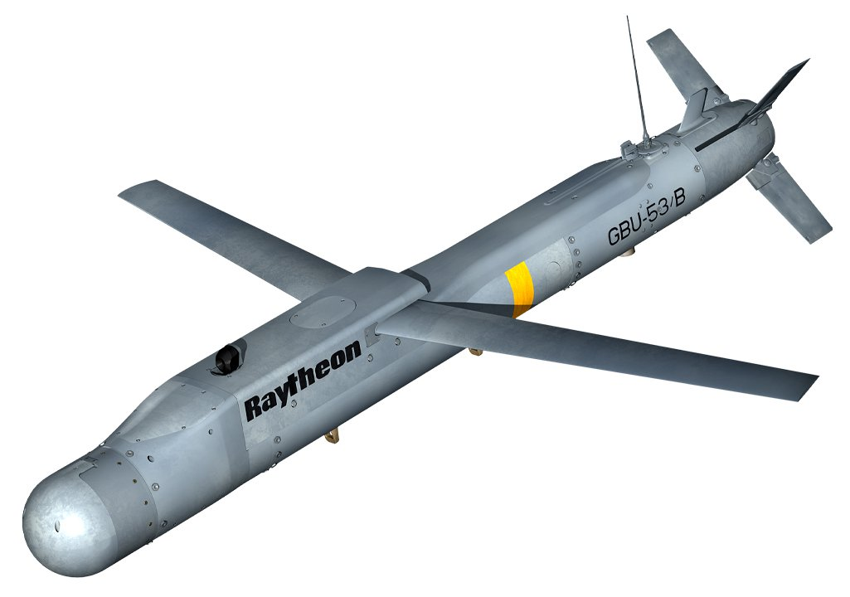
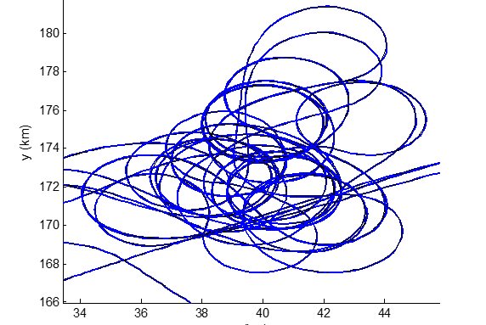
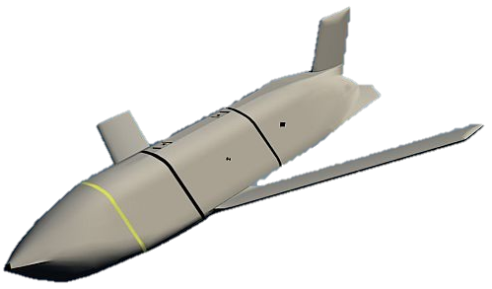
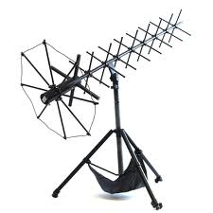
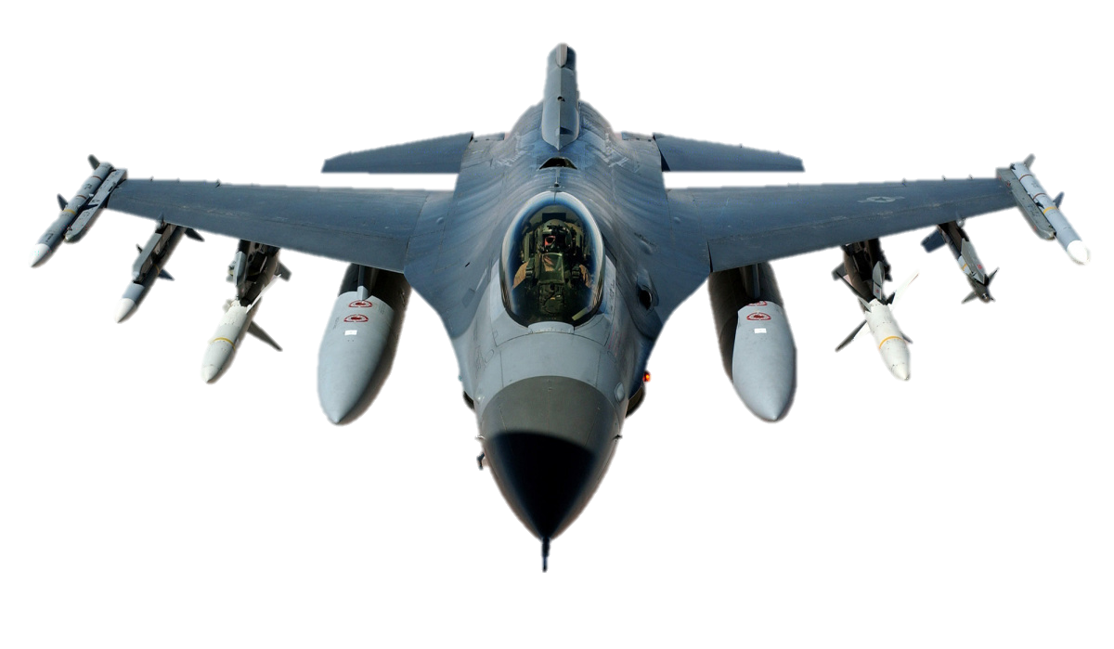
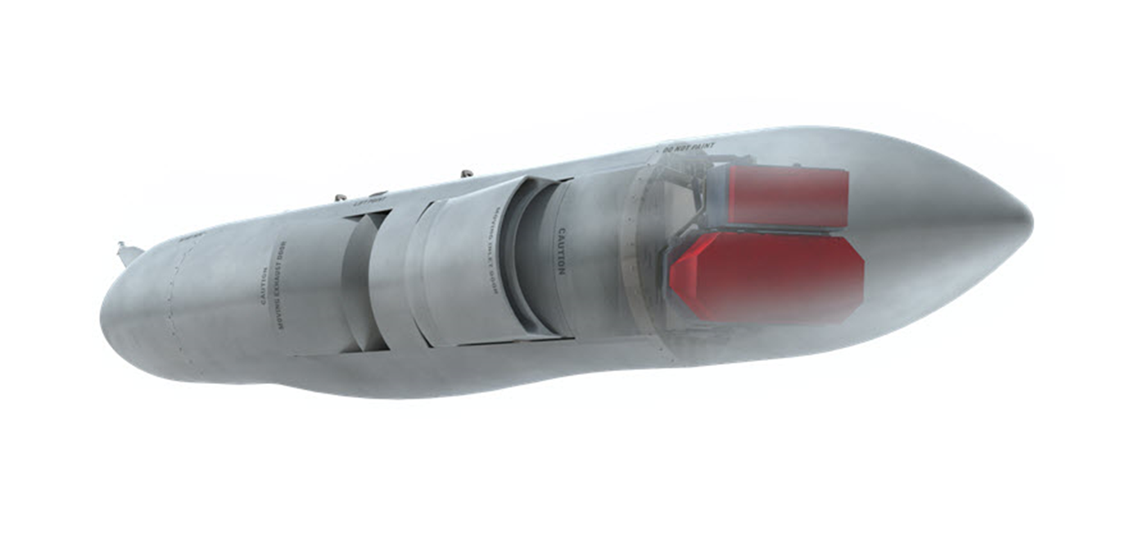
DoD yearly programs
~90 Yearly Major (ACAT I) programs
$93.2B
Platforms
Sensors
Data Processors
Jammers
Weapons
Network Links
Every program grades to their own requirements and coordinates external integration
~2,300 Yearly non-Major programs
$144.4B
Distribution Statement “A” (Approved for Public Release, Distribution Unlimited)
Notes:
Source: DISTAR 31297 brief for 2019 SPIE conference - slide #3

Slide 5
Current integration requires updates to several systems
A System of System is created by a user
Any translation happens inside the OFP before a message is sent out on the bus
Subsystem
OFP
Physical connection
Subsystems
Often datalinks (Link-16) must update their standard to pass new messages
3 generalized types of integration
Intra-subsystem (new algorithm)
Intra-aircraft (new subsystem)
Inter-aircraft (new external connection)
Translation from OFP to other systems
Bus
A translator is created for every new connection in the System of System
Distribution Statement “A” (Approved for Public Release, Distribution Unlimited)
Notes:
Source: DISTAR 31297 brief for 2019 SPIE conference - slide #7

Slide 6
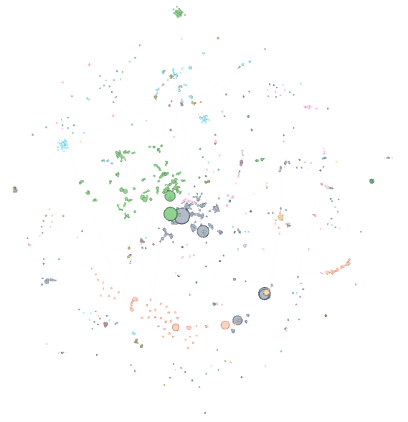
SoSITE integrates via a new toolchain called STITCHES
A System of System is created by a user
Translations are automatically created through collection of known pairs
Physical connection
Subsystems
OFP
Automatically created translations are separated from the OFP
Translations are optimized and at least as fast and precise as those created by hand
Distribution Statement “A” (Approved for Public Release, Distribution Unlimited)
Notes:
Source: DISTAR 31297 brief for 2019 SPIE conference - slide #8

Slide 7
SoSITE integrates via a new toolchain called STITCHES
A System of System is created by a user
Interfaces automatically created
producing STITCHES MDFs
Includes
Cross domain rulesets
Translation
Authentication
Bus monitors
Data filters
OFP Core
Interface
Physical connection
Subsystems
Shim
Shim
Filter
Transform
EM
Serialize
OFP
Deserialize
MAC
MAC
Transport
Transport
Automatically created translations are separated from the OFP
Distribution Statement “A” (Approved for Public Release, Distribution Unlimited)
Notes:
Source: DISTAR 31297 brief for 2019 SPIE conference - slide #9

Slide 8
Distribution Statement “A” (Approved for Public Release, Distribution Unlimited)
Notes:
Verbal soundtrack: generic DARPA transition description for 2020+ timeframe

